Slide 1
Foodstuffs Inventory Management and Recipe System
Group 4

Slide 2
Overview
01
02
03
04
05
06
Introduction
Functional Req.
Non-Functional Req.
Workload Delegation
Development Strategies
Potential Challenges

Slide 3
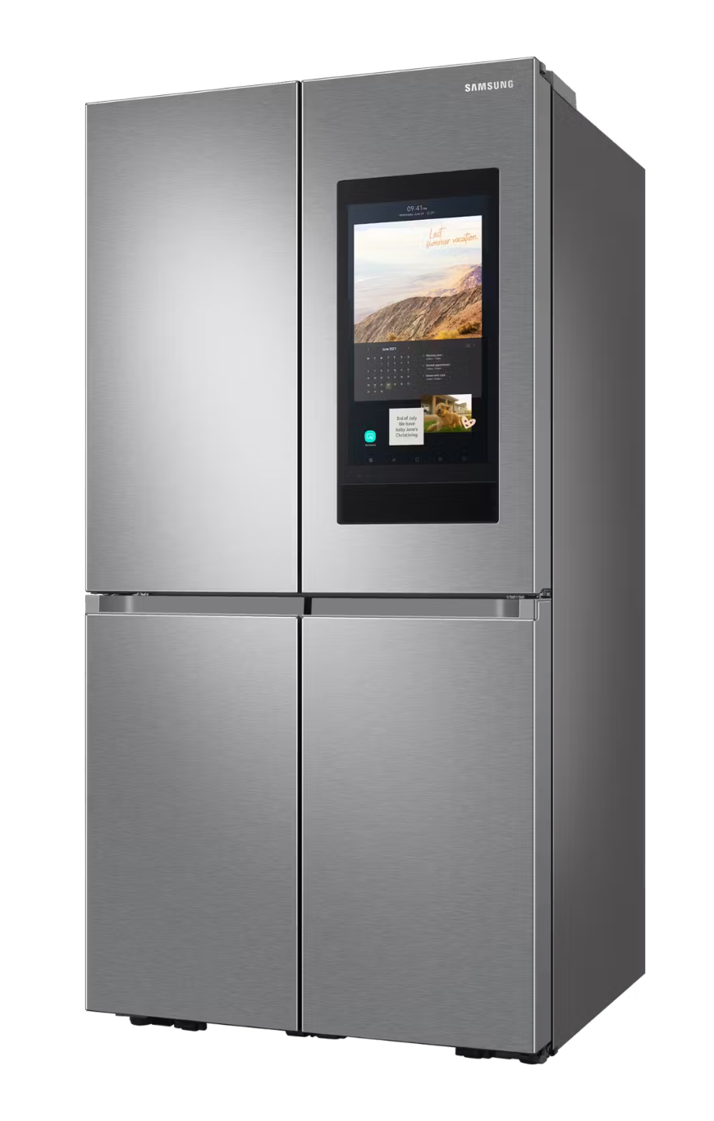
Introduction
An application that aims to assist people with Dietary Problems, Concerns, and/or Goals, as well as neurological disorders like Attention-deficit/hyperactivity disorder (ADHD) while meal planning and cooking. The app will be designed for use on a mobile device or on a smart fridge screen.
Common challenges caused by ADHD while cooking:
Hyper-focusing on perfecting one step while neglecting everything else
Managing different cooking times simultaneously
Being distracted by kitchen clutter

Slide 4
Functional Requirements
Inventory Tracker
Shopping List
Recipes
Add items into inv.
Remove items from inv.
Scan grocery items into inv.
Tracks quantity of condiment and partitioned goods after use
Identify untracked item usage
Modify Inv. based on completed recipes
Modify Inv. based on purchases
Tracks and alerts item expiration dates
Allow Substitutions for brand and price
Manually add new items
Alert to duplicate items
Display item count
Sort list by department
Wallet functionality to pay
Track grocery spending metrics
Alerts to products getting low
Recommend frequently bought items
Store database of user Recipes
Create Custom Recipes
Identify ingredients missing from a recipe
Sort Recipie DB based on available ingredients
Setup Meal Plan (Recipe Queue)
Append to shopping list based on meal queue
Sort recipes based on criteria tags
Allow Substitutions

Slide 5
Non-Functional Requirements
Color-Blind Friendly Palettes
Extensible Recipe List
App’s color palette for texts, backgrounds, and graphs should be color-blind friendly.
Built-in list of recipes to update on a regular basis to include new, fresh ideas from external database.
User-Friendly Interface
Compatibility
App’s interface must simple, clutter-free, and intuitive, allowing for easy navigation with minimal distractions
App should be compatible with large percentage of smart fridge OS’, including being able to adapt to different hardware requirements.
Responsiveness
Accessibility
The app must maintain smooth and quick responses to user interactions, ensuring menial lag to avoid user frustration
The app should follow accessibility standards to assist users with ADHD and other conditions

Slide 6
Workload Delegation
Braedon
Bryan
Fardin
Andrew
Evan
Zifeng
Interview Stakeholders
Begin UI Wireframing
Examine Database Solutions
Develop Core App Features
Create Detailed User Personas
Research ADHD-Friendly Design Practices
Implement shopping list
Develop notifications
Create help guide
Research Potential API’s
Ensure program optimization
Develop Front End Experience
Integrate API with app
User Interface improvements
Implement Inventory Tracker
Implement recipe database
Ensure UI accessibility
Research effective HCI designs

Slide 8
Potential Challenges
Recipe Database
Inventory Management Accuracy
Hardware Limitations
Recipe database would have to be maintained during the lifespan of the program, and may require interfacing with API’s
Ensuring that the inventory in the fridge is accurate, especially if the user forgets to update the inventory
Some smart fridges may have different hardware limitations, which could limit the programs efficiency

Slide 9
Strategies for Potential Challenges
Recipe Database
Inventory Management Accuracy
Hardware Limitations
Coordinate with API system
Prompting User to Update
Research Limitations
Researching and finding a suitable API that would work with our program could alleviate individually maintaining the database.
Prompt user on regular basis to ensure accuracy, alongside implementing an easy to use way to update the database (i.e. QR scanner for receipts)
Coordinate and understand the hardware in smart fridges before starting development to alleviate issues that come up during development.

Slide 10
Thank You!

